Slide 1
Relative Importance of Golf Courses for Bats Influenced by Landscape Context in Northeastern U.S.
Evan Drake
Brooke Maslo
Department of Ecology, Evolution and Natural Resources, Rutgers, The State University of New Jersey

Slide 2
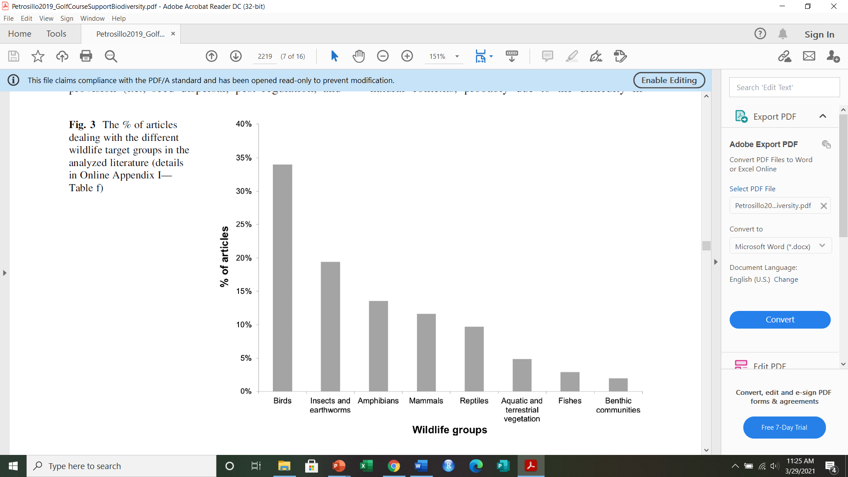
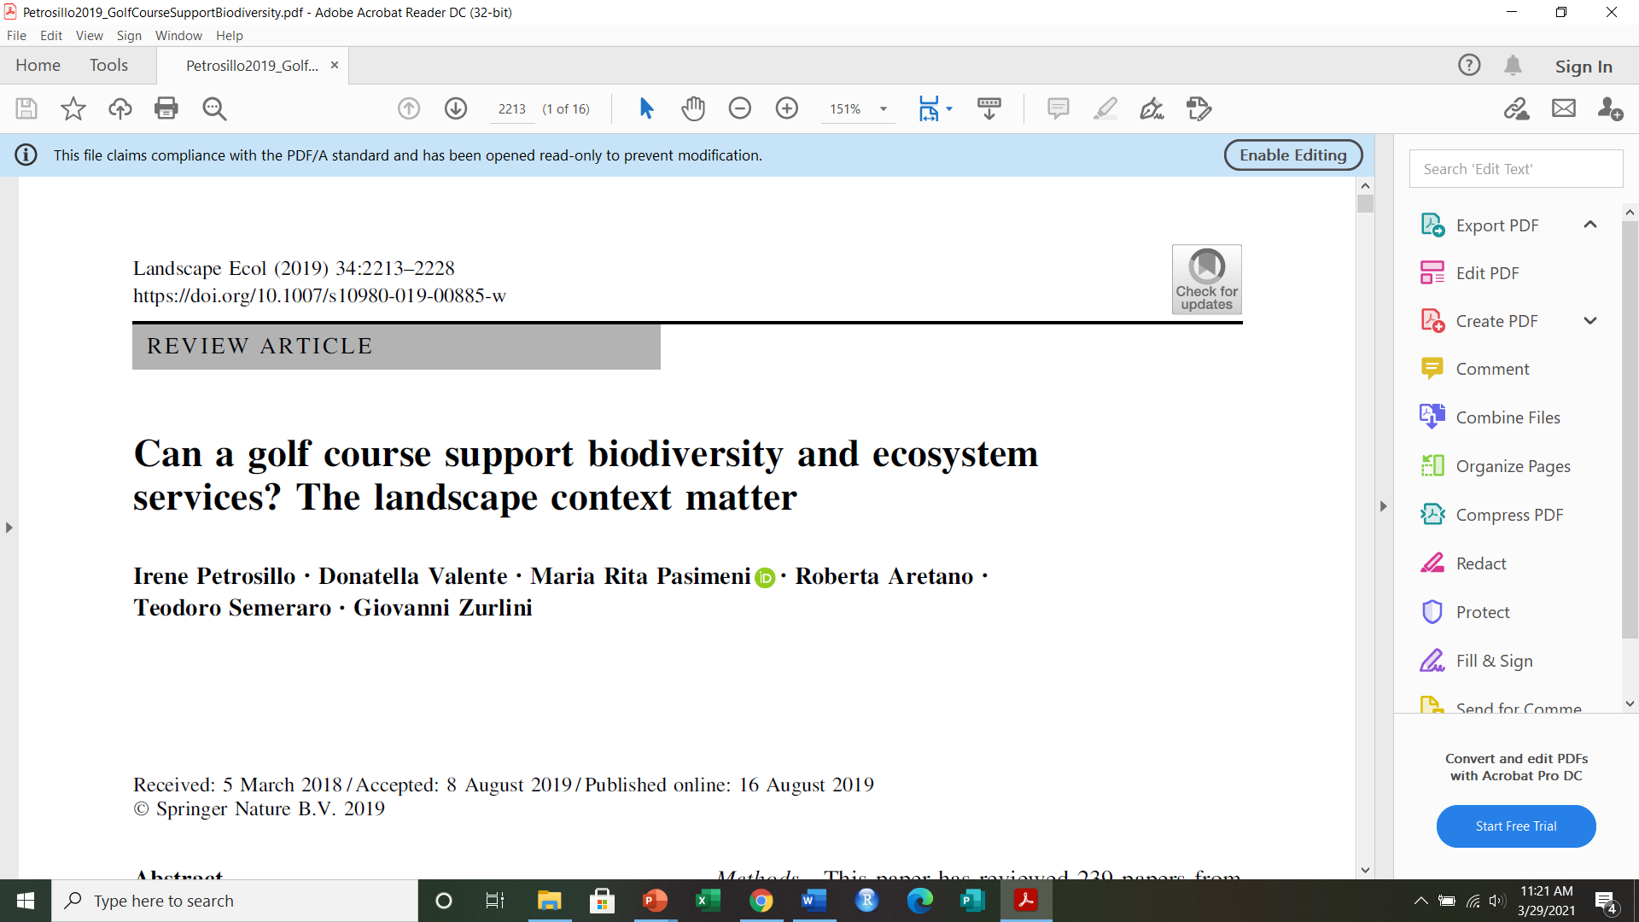
Wildlife Studies on Golf Courses
~ 55%

Slide 3
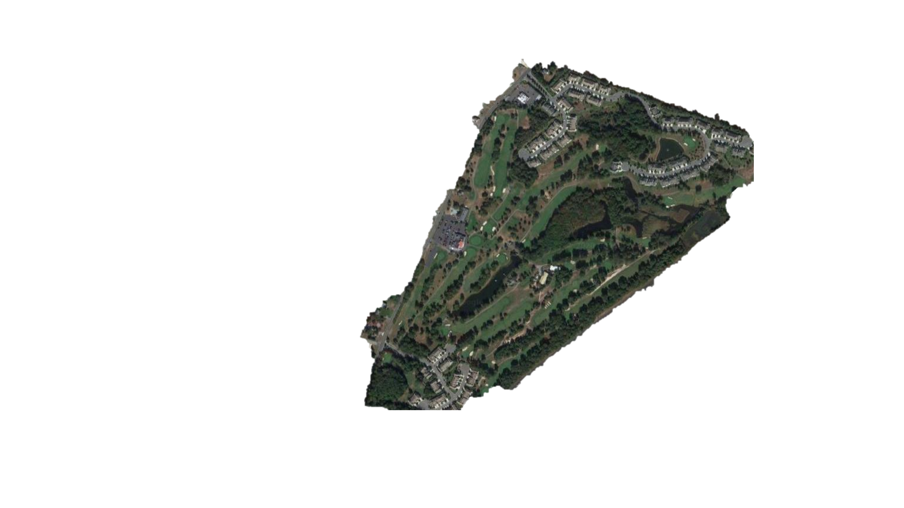
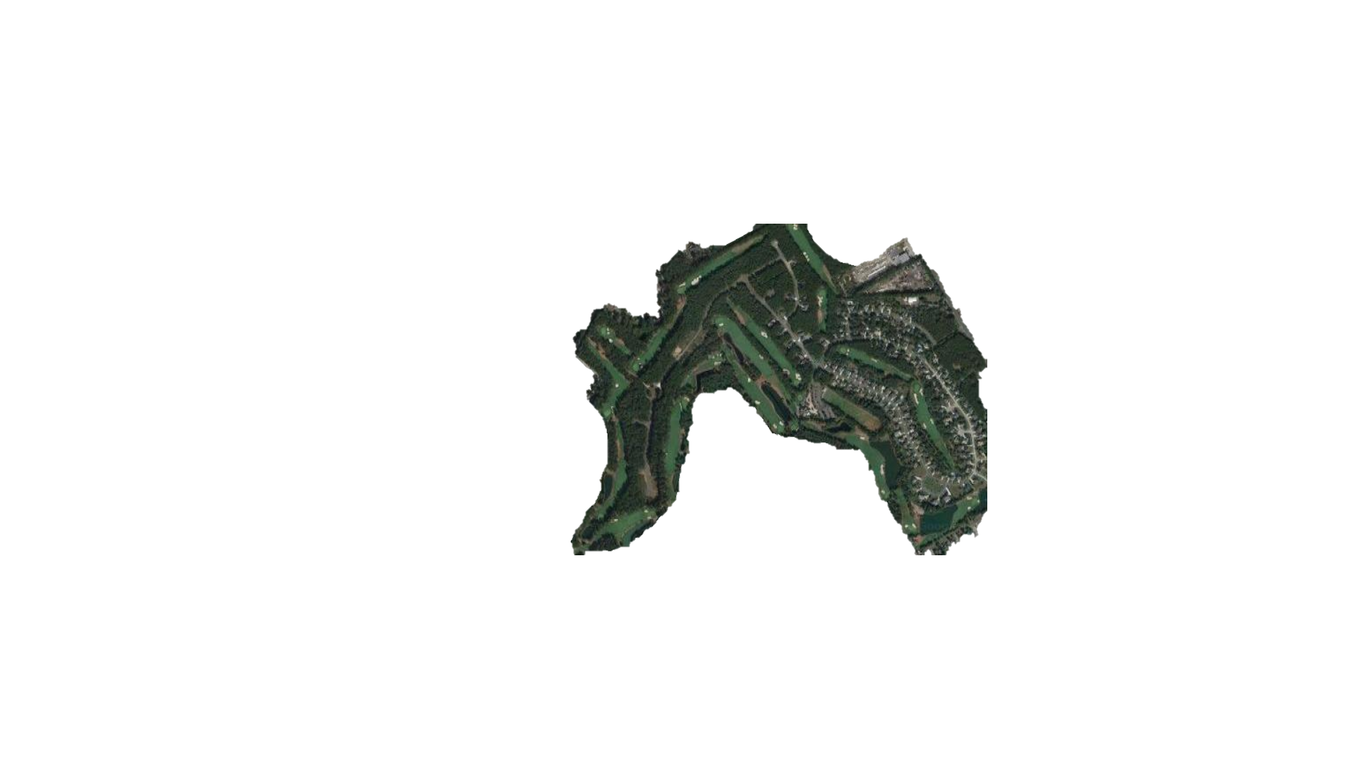
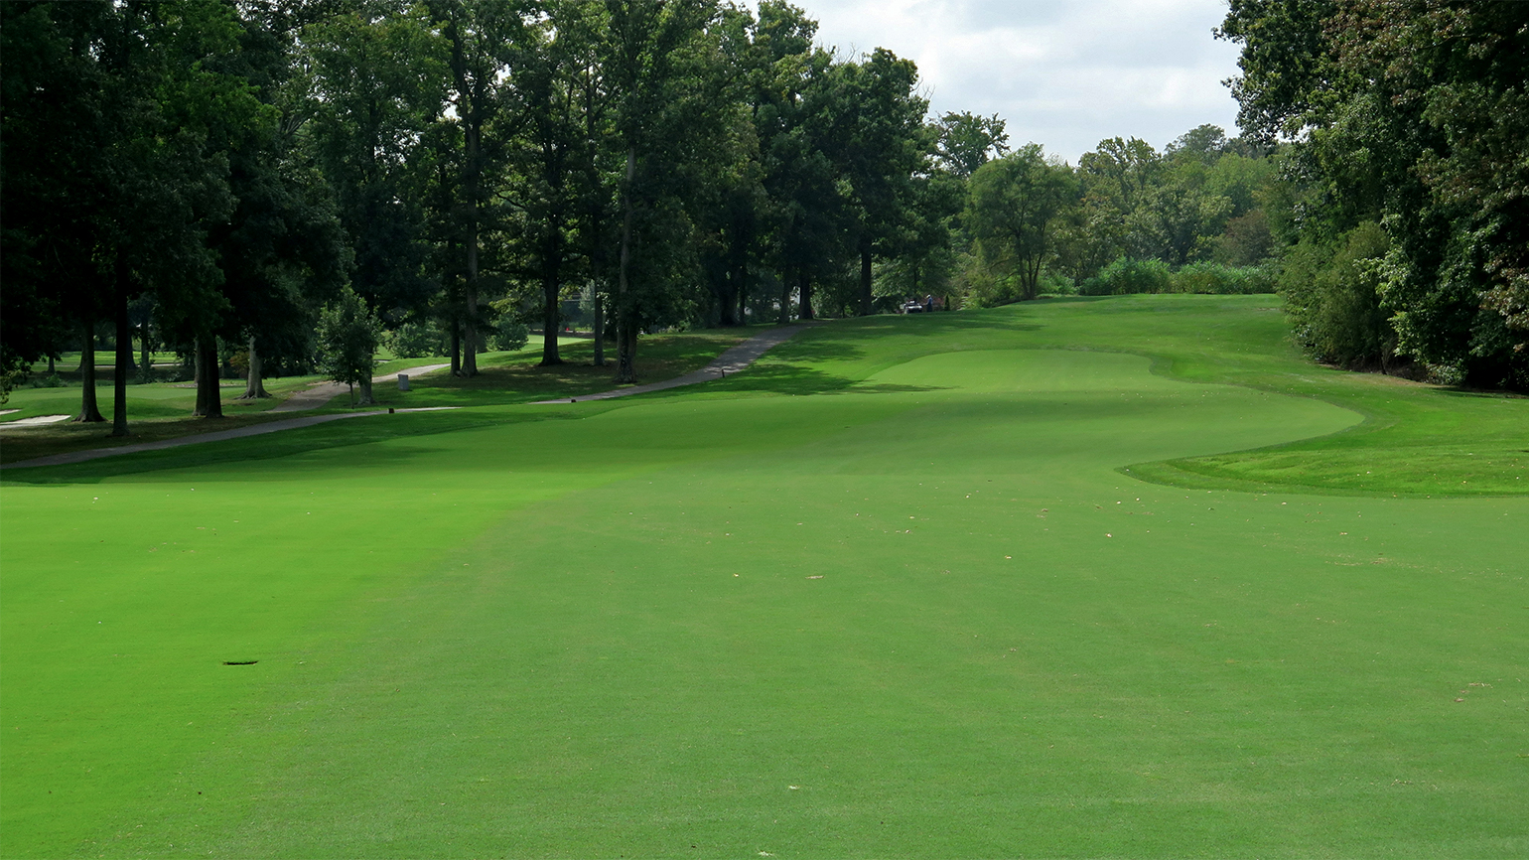
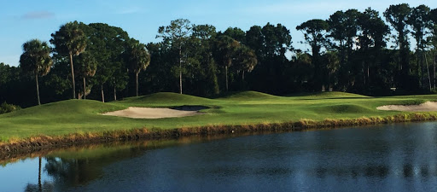
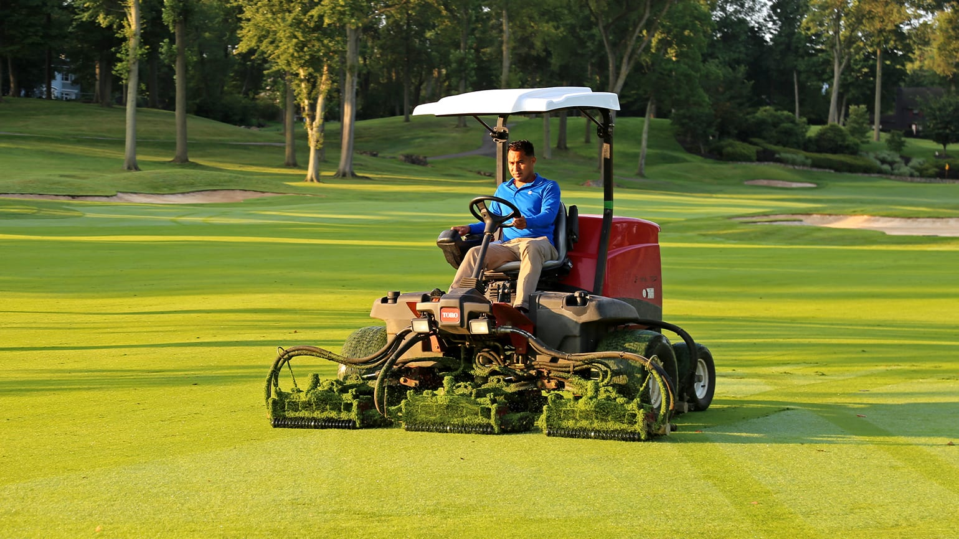
Golf Course = Habitat Patch
Similar in…
Size
Features
Plant species
Security
Maintenance regime
Differ in surrounding matrix

Slide 4
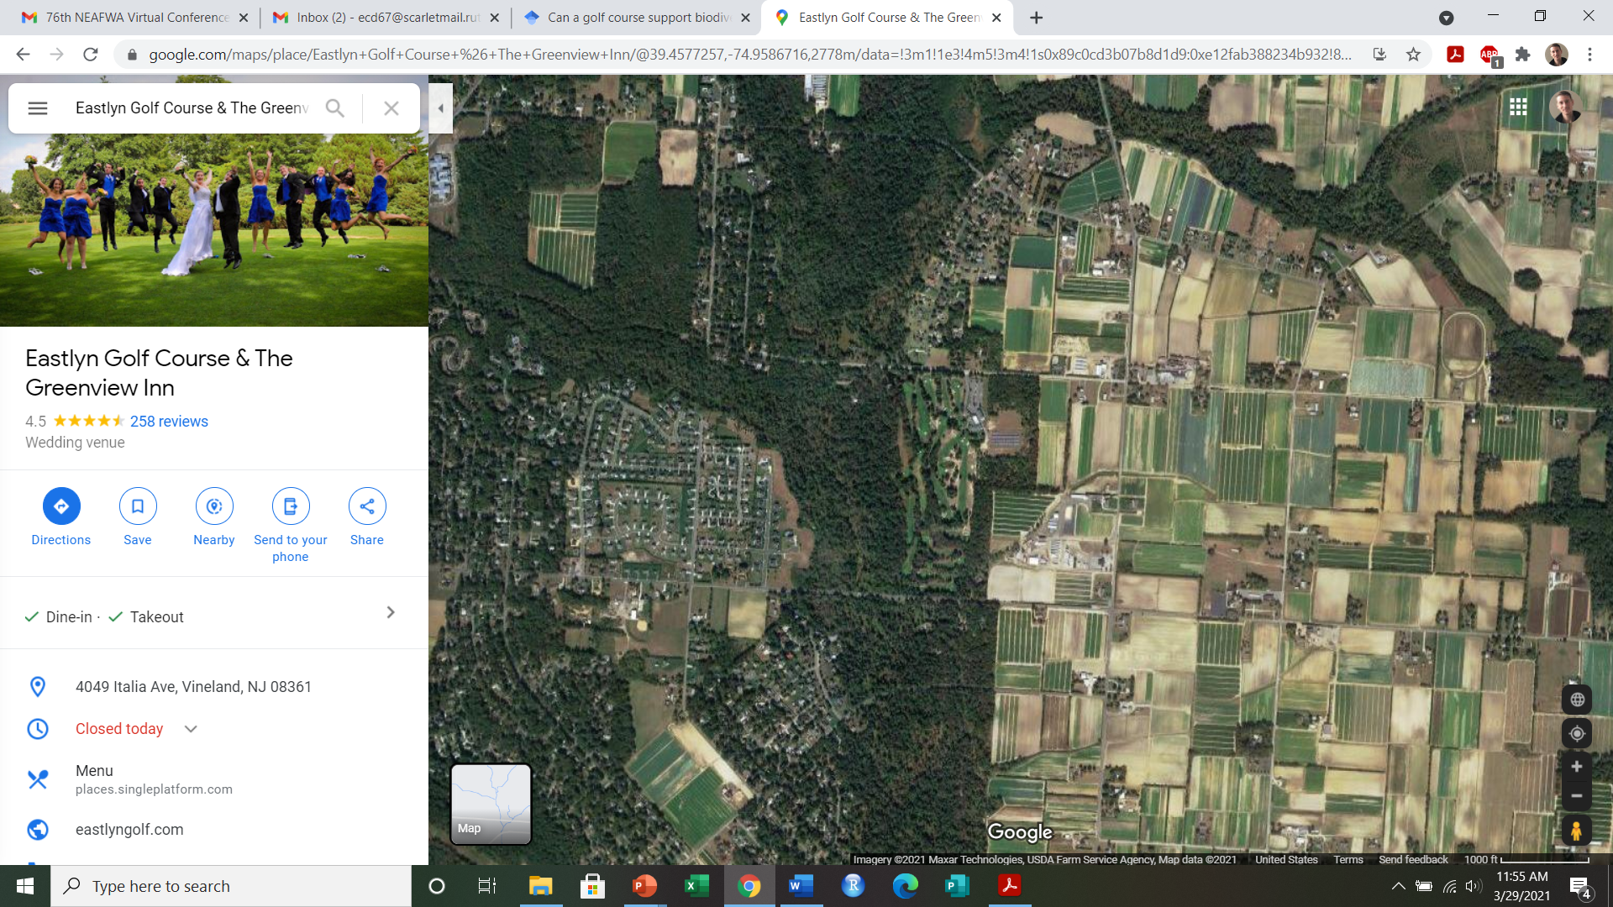
Landscape Matrix

Slide 5
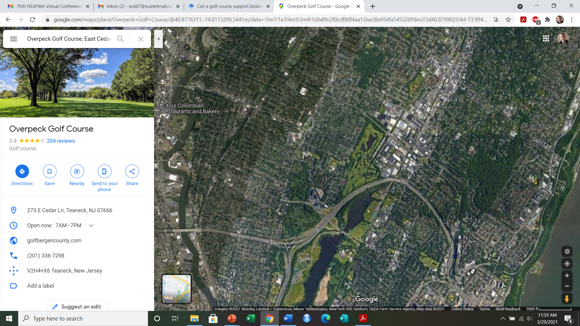
Landscape Matrix

Slide 6
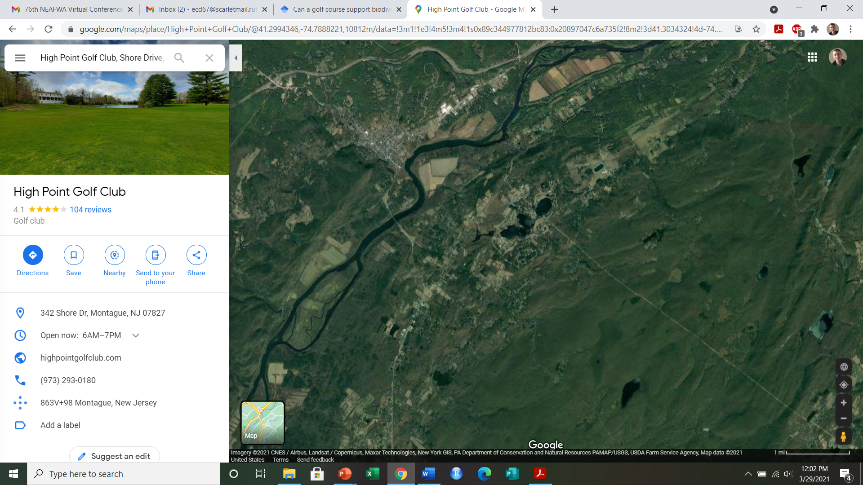
Landscape Matrix

Slide 7

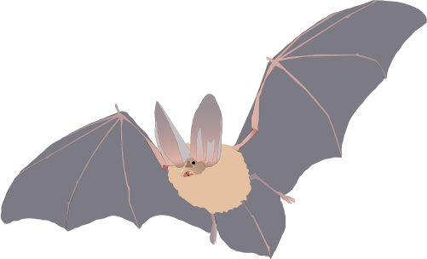

In what type of landscape are golf courses more important for bats?
Question
Passive acoustic monitoring
Manual echolocation analysis
GIS data
General activity models
Feeding activity models

Slide 8
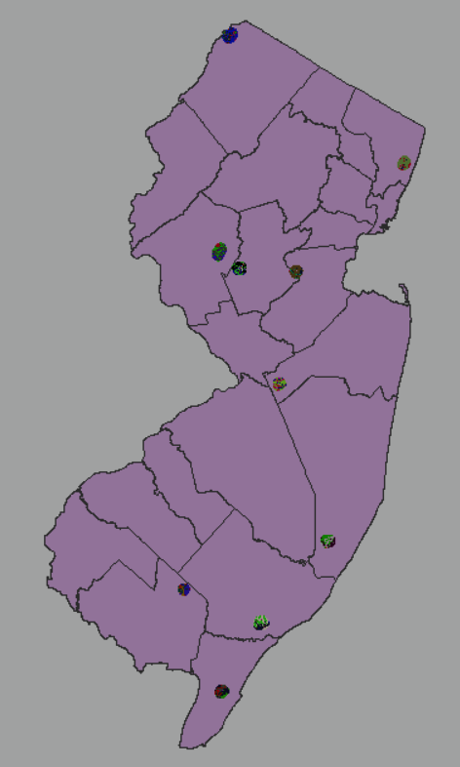
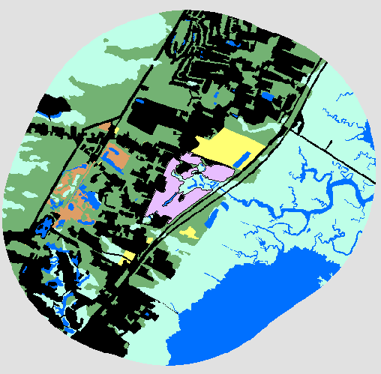
Study Sites
2km radius

Slide 9
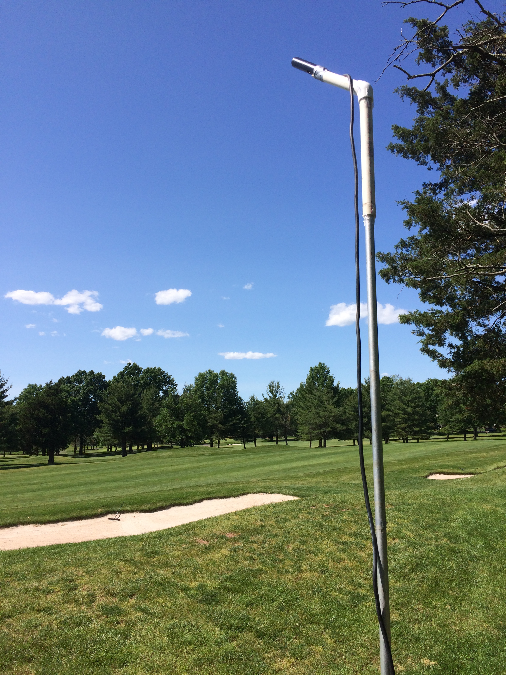
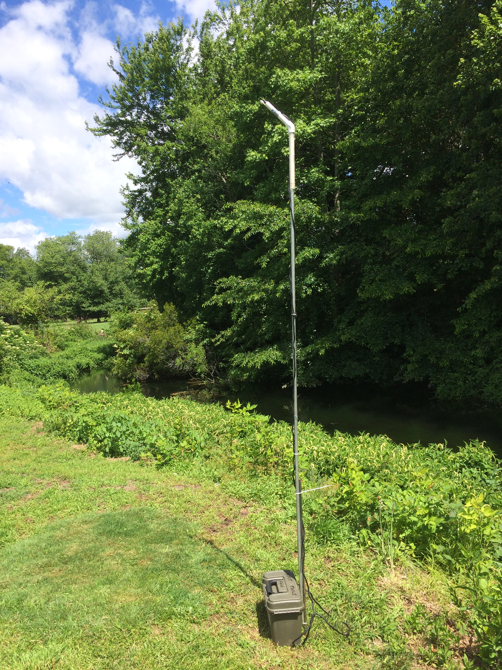
Acoustic Monitoring

Slide 10
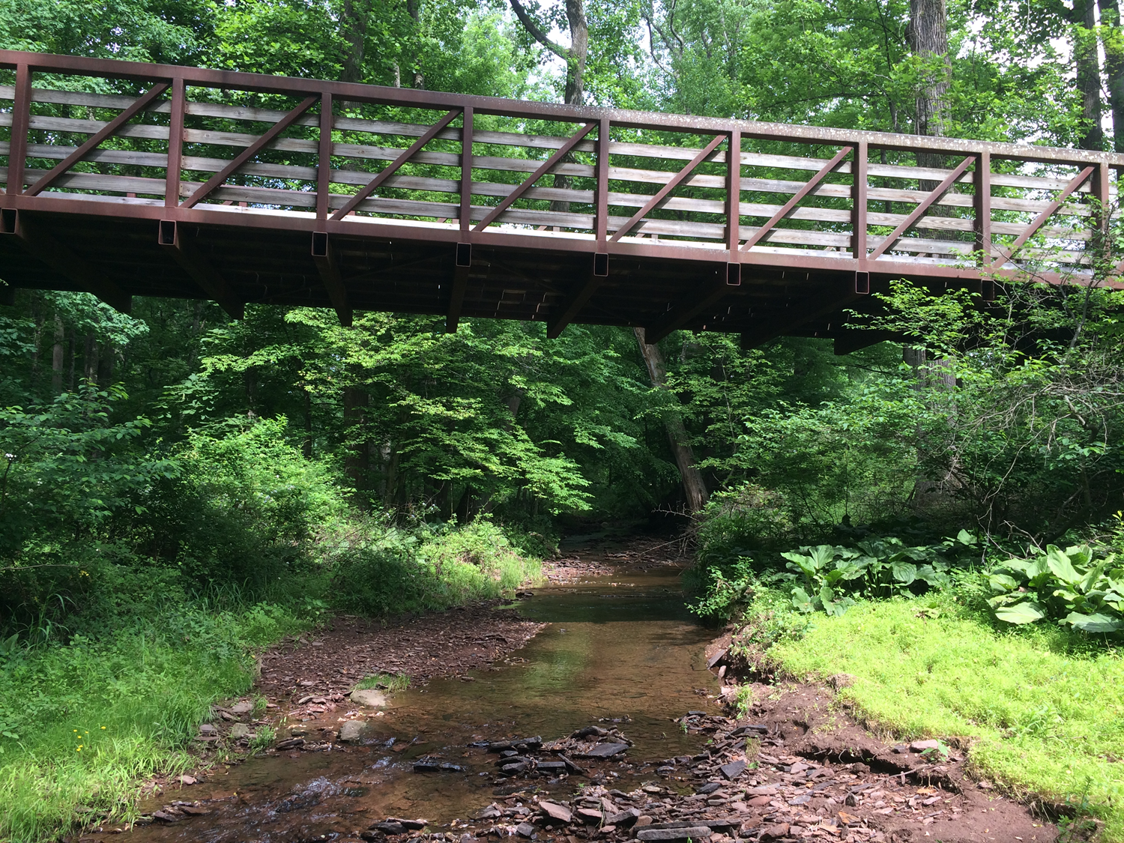
Acoustic Monitoring

Slide 11
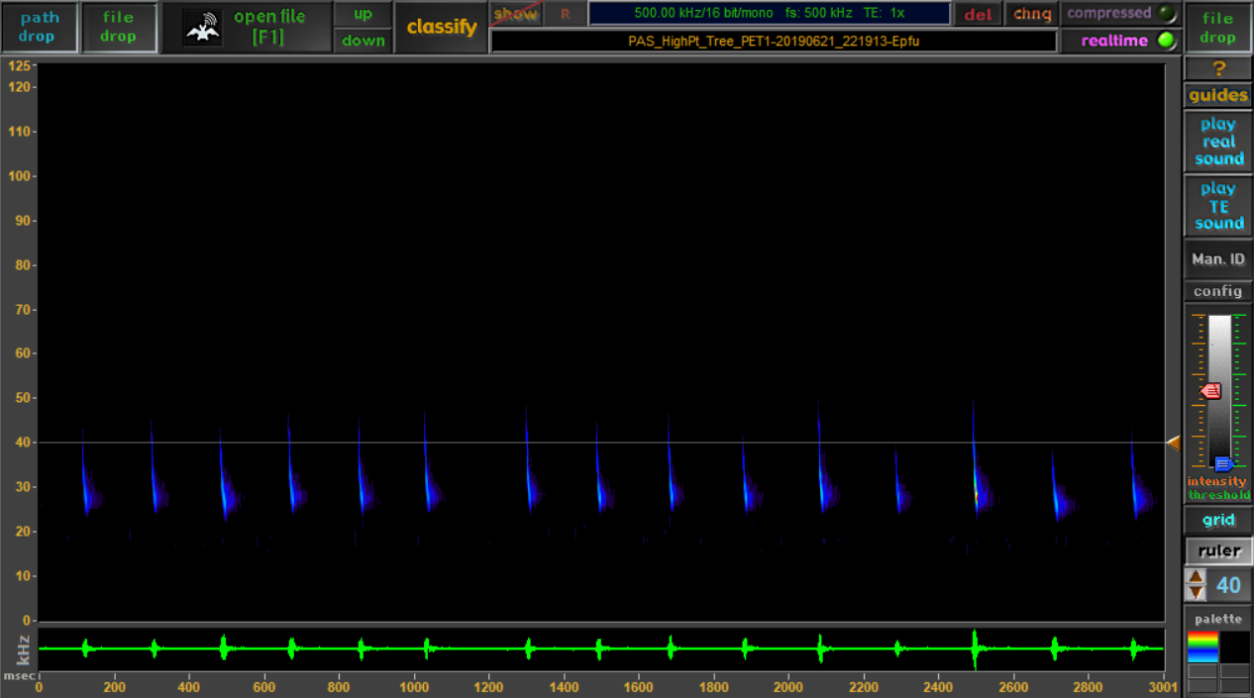
Echolocation Analysis

Slide 12
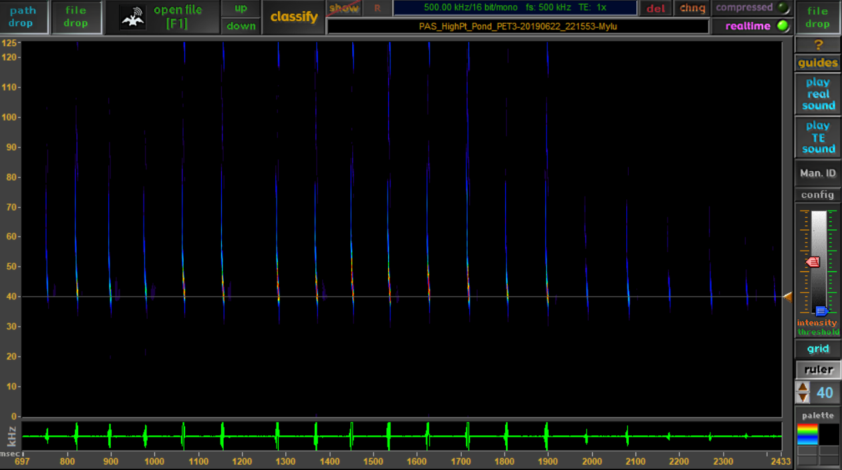
Echolocation Analysis

Slide 13
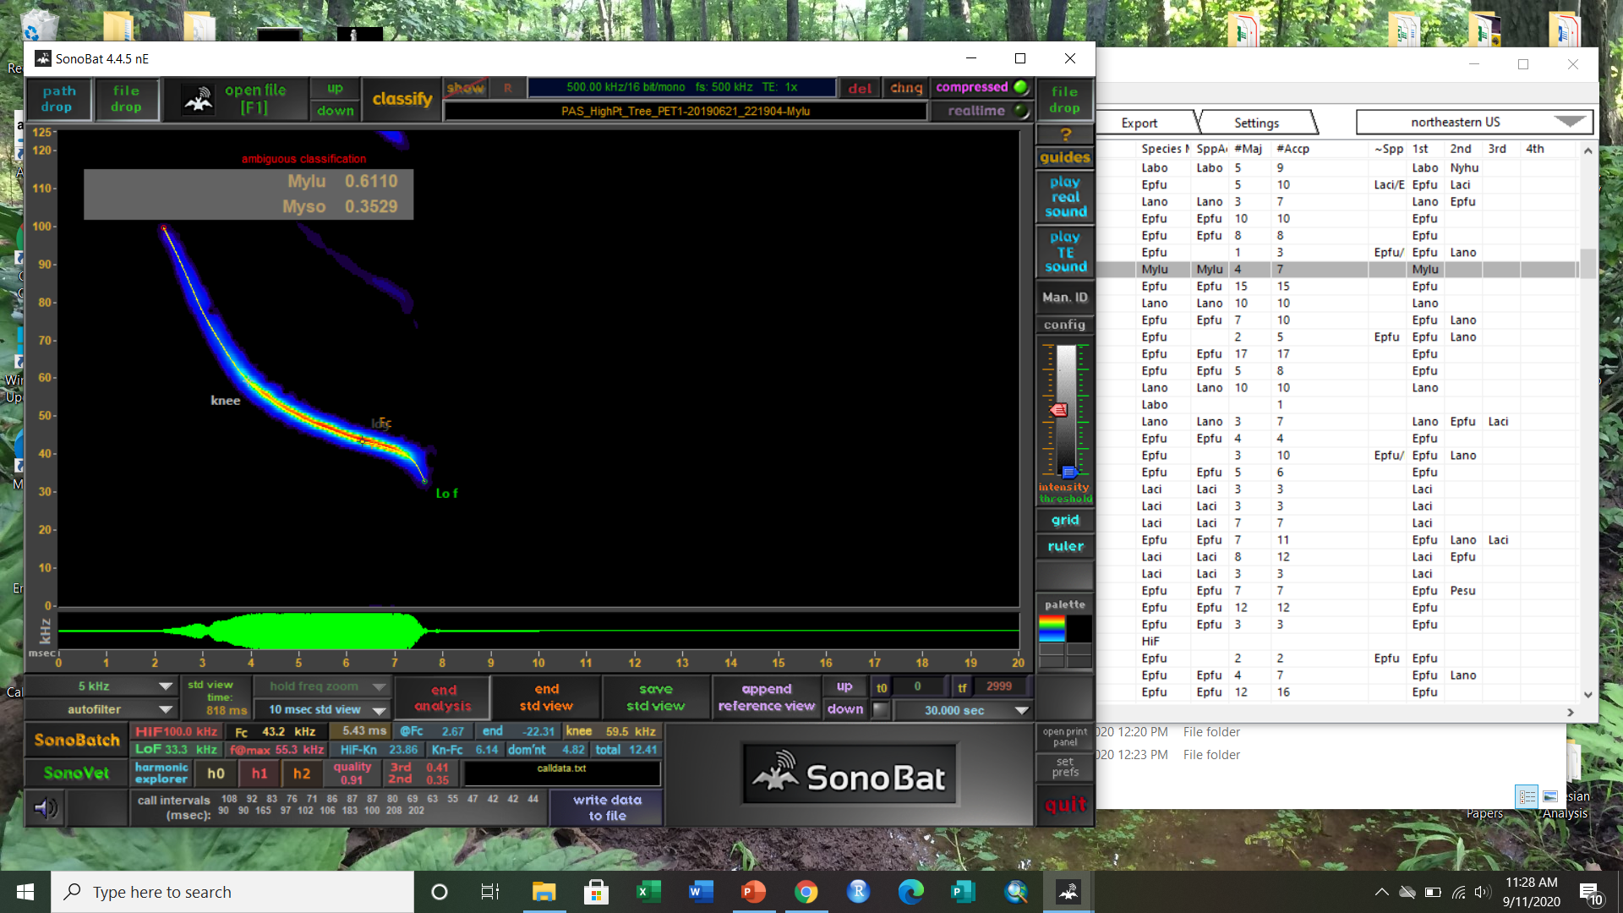
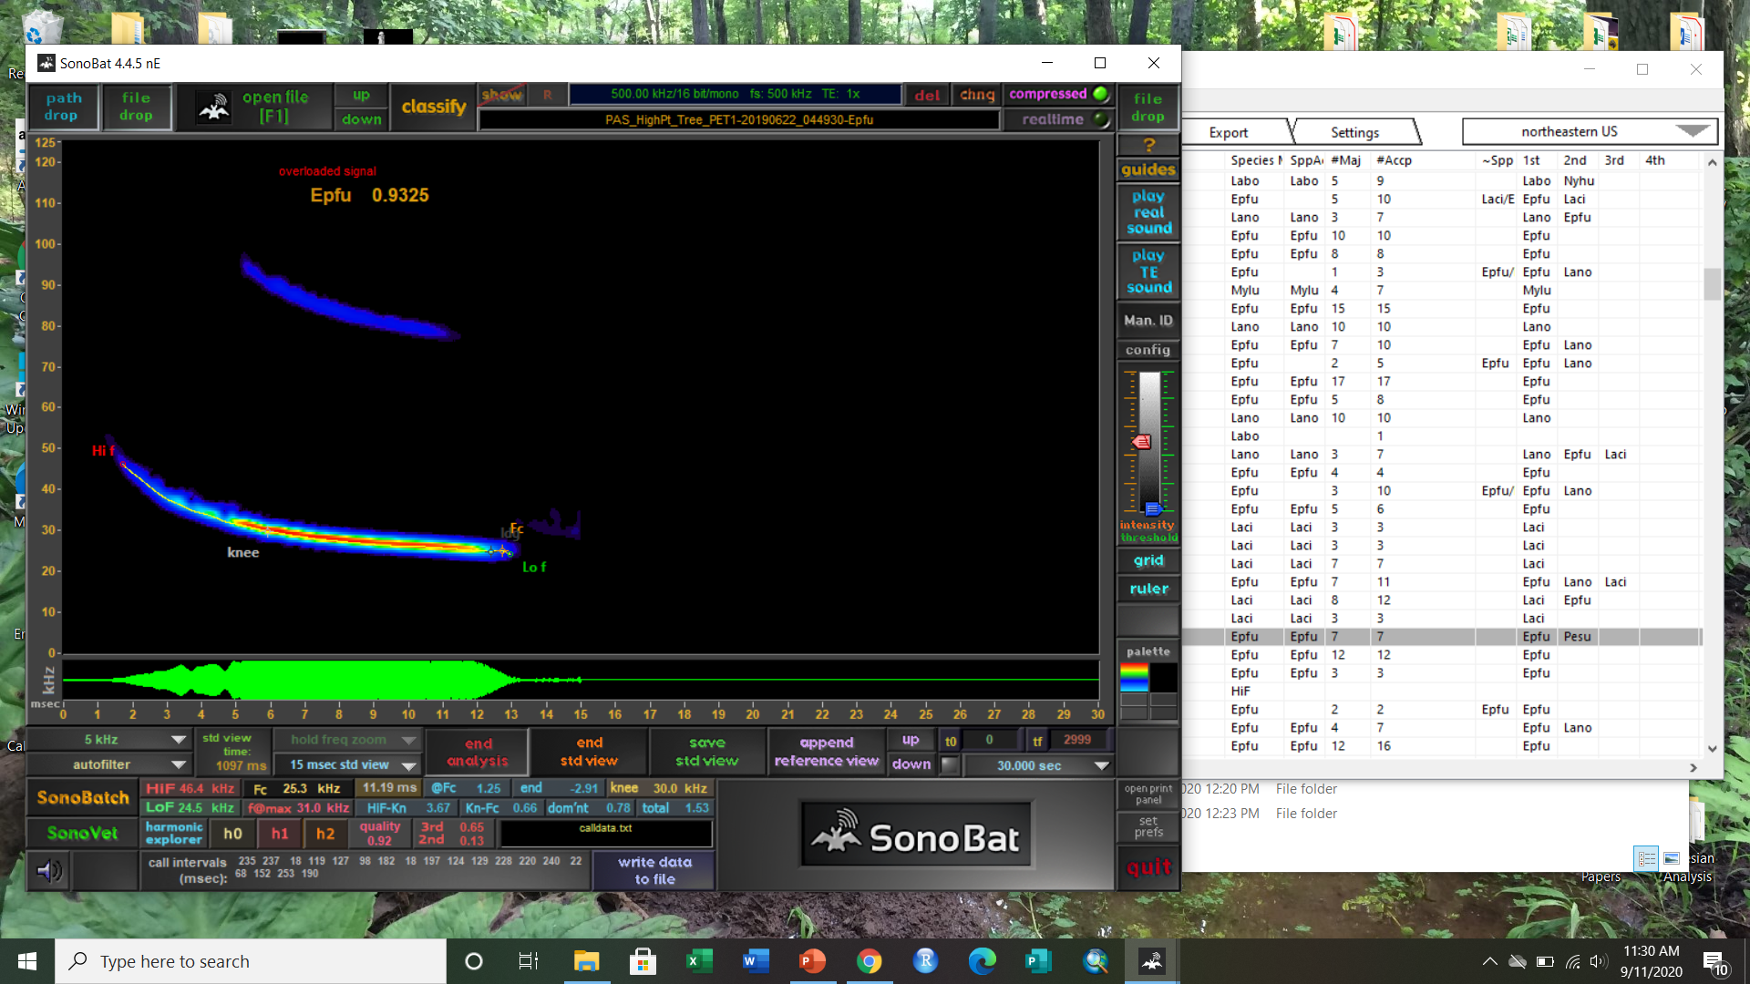
Echolocation Analysis

Slide 14
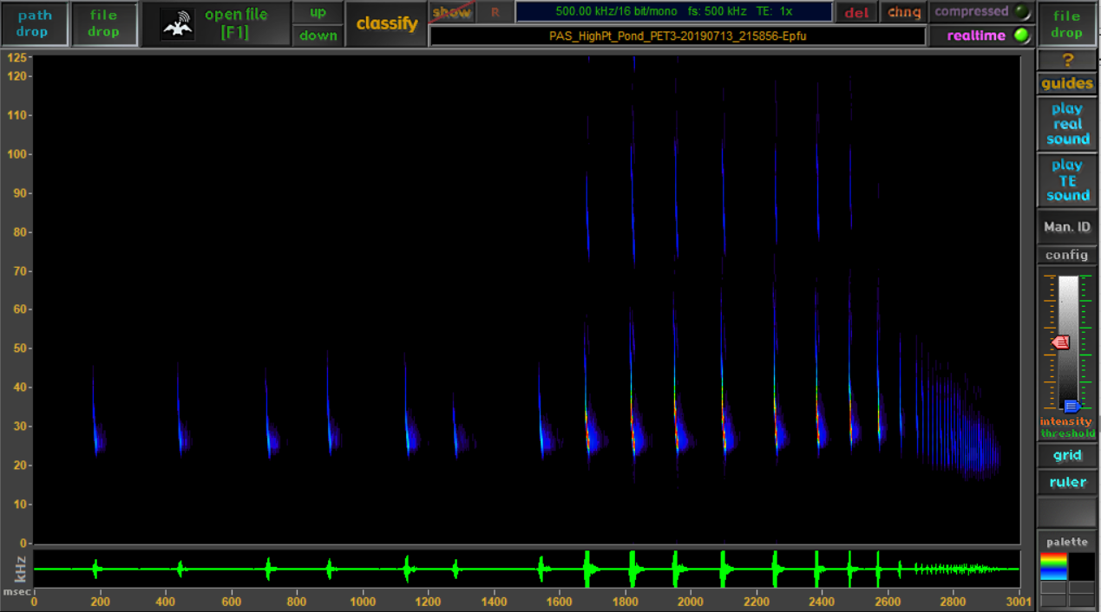
Echolocation Analysis

Slide 15
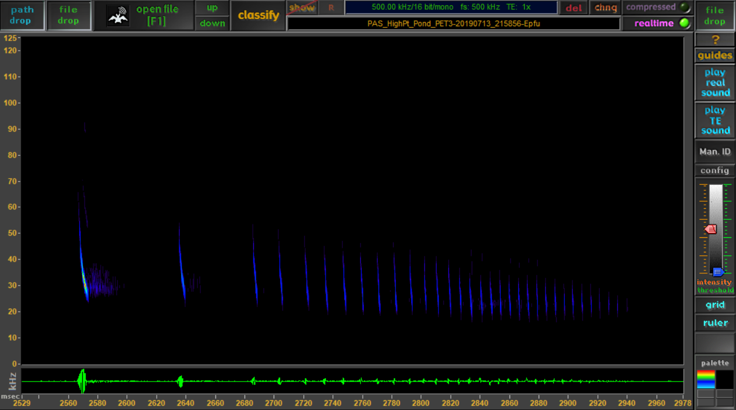
Echolocation Analysis

Slide 16
Activity Models
We treated each detector night on each course as a data point
How much total activity was observed?
How much activity per species?
How much feeding activity was observed?
Response variables

Slide 17
Activity Models
Urban area %
Suburban area %
Open%
Forested streams
Largest patch of forest
Response variables
Predictor variables

Slide 18
 | Streams | Urban | Suburbs | Forest LPI | Field | Agriculture
Streams | 1.00
Urban | -0.32 | 1.00
Suburbs | -0.003 | 0.64 | 1.00
Forest LPI | 0.24 | -0.48 | -0.41 | 1.00
Field | -0.34 | 0.69 | 0.11 | -0.21 | 1.00
Agriculture | 0.38 | -0.56 | -0.17 | -0.28 | -0.66 | 1.00

Slide 19
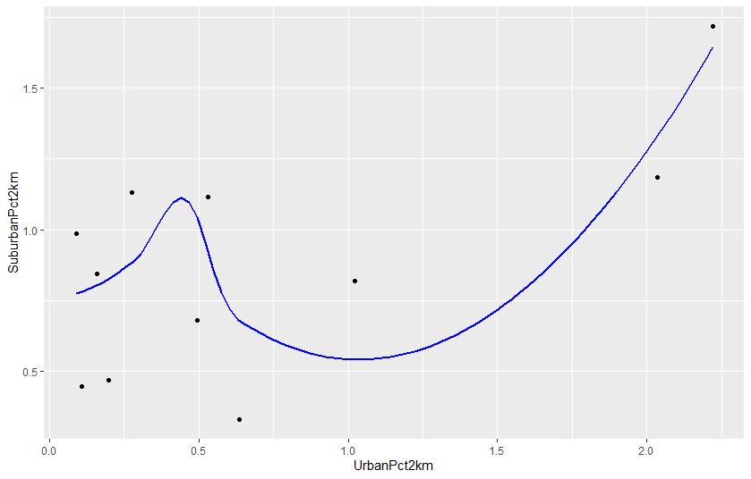
Suburbs vs. Urban

Slide 20
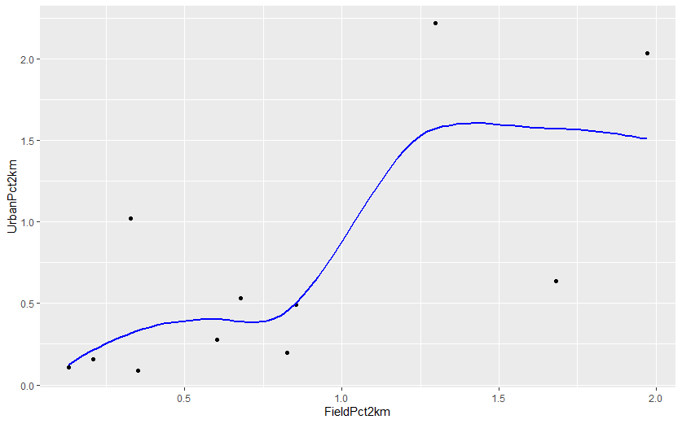
Fields vs. Urban

Slide 21
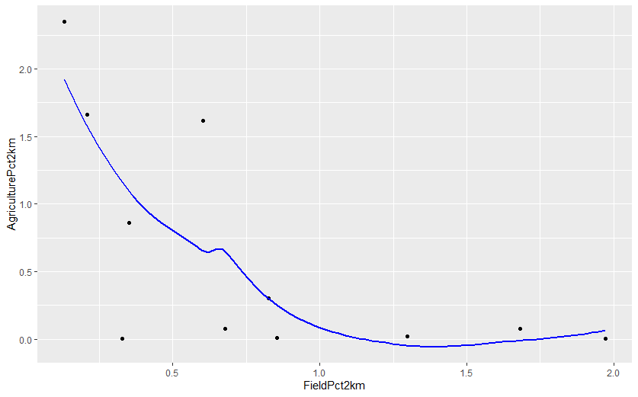
Fields vs. Agriculture

Slide 22
Activity Models
I had repeated measures for each…
Year
Site
Response variables
Generalized linear mixed-effects model
(GLMM)
Predictor variables
Random effects:
Year and Site

Slide 23
Activity Models
I used nested model selection:
Removed the variable with the lowest effect size until all remaining contributed significantly to the model
Response variables
Generalized linear mixed-effects model
(GLMM)
Predictor variables
Model selection
Interpret the winners
Random effects:
Year and Site

Slide 24
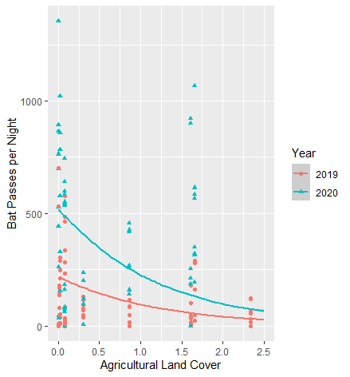
Activity Models
Fixed effects:
estimate p-value
Field% -1.00 0.004 **
ForestLPI -0.65 0.007 **
Agriculture% -0.83 0.0009 ***
Total bat activity on golf courses was lower in areas with more agriculture, fields, and large patches of forest

Slide 25
Activity Models
Fixed effects:
estimate p-value
Field% -1.00 0.004 **
ForestLPI -0.65 0.007 **
Agriculture% -0.83 0.0009 ***
Total bat activity on golf courses was lower in areas with more agriculture, fields, and large patches of forest
Flip that by saying that bats are attracted to golf courses when:
Forests are fragmented
Open spaces are scarce

Slide 26
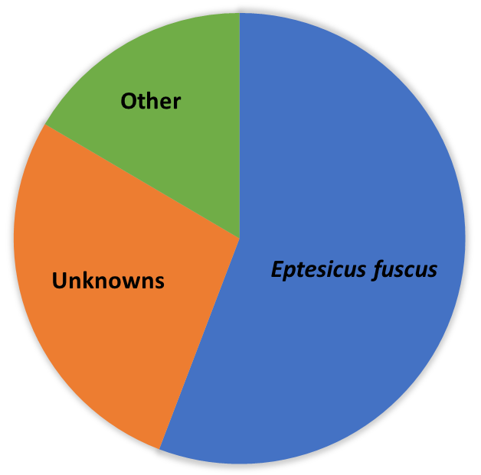
Conclusions

Slide 27
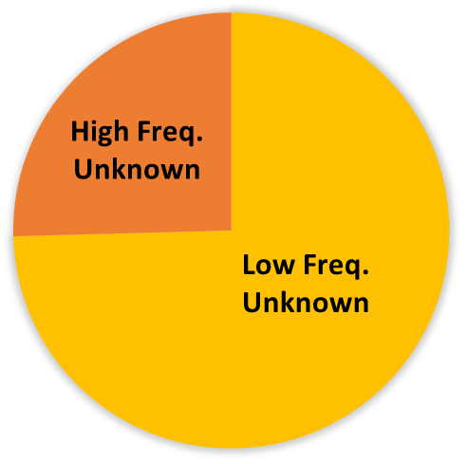
Conclusions

Slide 28
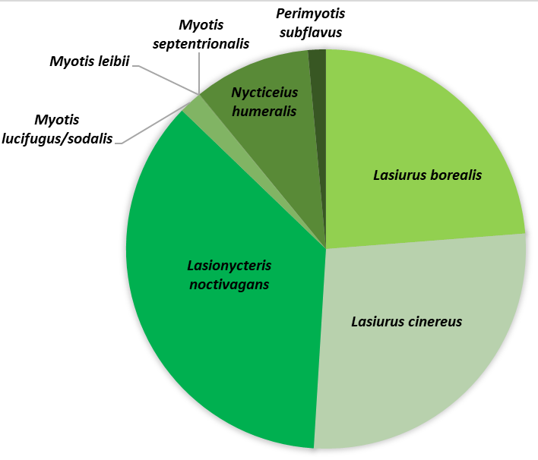
Conclusions

Slide 29
Golf Course vs. Landscape effects are species-dependent
Conclusions
Species | Streams | Suburban | Open | Forest LPI | Urban
Perimyotis subflavus | -7.58 |  | 4.16 | 5.66 | 4.34
Myotis lucifugus/sodalis |  |  | -2.65 |  | -1.46
Nycticeius humeralis | -8.44 | 6.82 | -3.27 |  | -4.95
Lasiurus borealis | -2.04 | -1.49
Lasiurus cinereus | -1.70
Eptesicus fuscus |  | 1.00

Slide 30
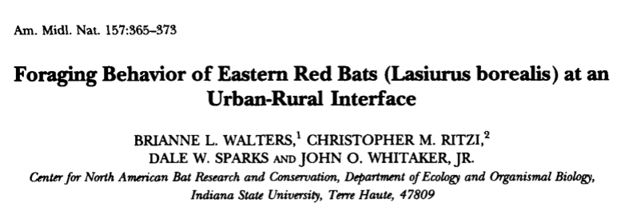
Bats come to golf courses to find rare habitats
Conclusions
Example: the eastern red bat (Lasiurus borealis)
A tree-roosting bat
Forages on forest edges, fields, and over water
Avoids urban areas

Slide 31
Bats come to golf courses to find rare habitats
Conclusions
Example: the eastern red bat (Lasiurus borealis)
A tree-roosting bat
Forages on forest edges, fields, and over water
Avoids urban areas
Species | Streams | Suburban | Agriculture | Field | Forest LPI | Urban
Lasiurus borealis | -2.23 | -1.49 |  | -1.97 |  | 1.32

Slide 32
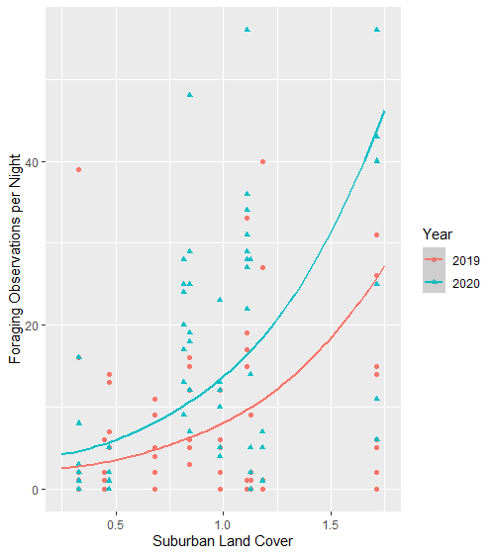
Activity Models
Fixed effects:
estimate p-value
Forest edge 1.50 0.0068 **
Suburban% 1.63 5.36e-05 ***
Stream (km) -1.48 5.98e-05 ***
Total feeding activity on golf courses increased in more suburban areas

Slide 33
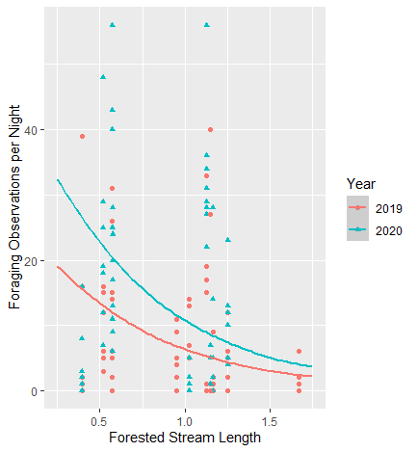
Activity Models
Fixed effects:
estimate p-value
Forest edge 1.50 0.0068 **
Suburban% 1.63 5.36e-05 ***
Stream (km) -1.48 5.98e-05 ***
Total feeding activity on golf courses increased in more suburban areas
But it decreased in areas with more streams in the landscape

Slide 34
Golf courses are more important when the surrounding landscape…
Conclusions
… provides more roosting habitat
… provides less foraging habitat
… differs from habitat provided by the golf course

Slide 35




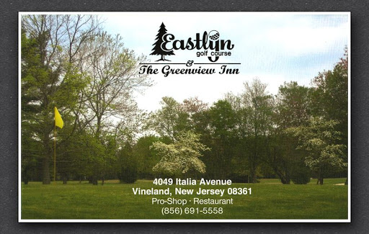



Thank you, to everyone working at the golf courses
Acknowledgements
and to everyone who helped give me ideas or tools
Bob Lowrie (Cream Ridge)
Lisa Jensen (Rutgers)
George Pierpoint (Harbor Pines)
Brad Miller (Sea Oaks)
Darrell Marcinek (Neshanic Valley)
Rob Arnts (Stanton Ridge)
Edd Becica (Avalon)
Rob Buono (Eastlyn)
Bret Roby (High Point)
Paul Park (Overpeck)
Scott Binkley (Atlantis)
Matt Waina
MacKenzie Hall
Jeff Brown
Mike Allen
Robert Kwait

